Slide 1
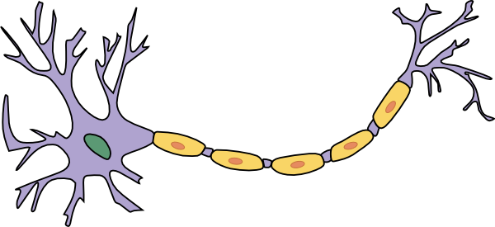
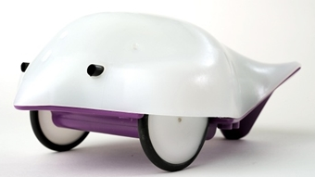
Cartoon Network
Installation
Basics
Connecting to a Finch robot

Slide 2
Cartoon Network: Installation
Make sure you have Java installed on the computer you are using.
https://java.com/en/download/
Download cartoon_network.jar from GitHub:
https://raw.githubusercontent.com/rcalinjageman/cartoon_network/master/cartoon_network.jar
https://github.com/rcalinjageman/cartoon_network
Double-click the cartoon_network.jar to launch the file.

Slide 3
Cartoon Network: Basics
Type “A” to enter Add mode
Then click around the screen to add neurons
Type “X” to enter eXcite mode
Then each click on a neuron excites the neuron.
You’ll see it release neurotransmitter which then jiggles around for a few moments, potentially activating partner neurons
Type “M” to enter Move mode
Click and drag neurons.
Make a simple circuit

Slide 4
Cartoon Network: Basics
Type “R” to enter Rotate mode
Click a neuron to rotate it counter-clockwise by a bit
Type “G” to enter Grow mode
Click a neuron to stretch it out a bit
There is also a shrink mode (“S”)
Type “W” to enter Transmitter mode
Click a neuron, and then choose if it will release glutamate (excitatory) or GABA (inhibitory)

Slide 5
Cartoon Network: Basics
Menu system
Click on the label for the current mode
Select an option

Slide 6
Cartoon Network: List of Modes
Edit Network:
(A)dd
(D)elete
(R)otate
(S)hrink
(M)ove
Experiment:
e(X)cite
i(N)hibit
Change Neurons:
Activity (T)ype
Activity (L)evel
Transmitter Type (w)
Transmitter Amount (q)
FINCH:
(C)onnect
(I)Nputs
(O)utputs
Temp Threshold (-)
Light Threshold (0)

Slide 7
Cartoon Network: Connect to a “Finch”
Plug in a Finch via USB – the lights in the nose will throb
Type “C” to connect the Finch to the simulation
The lights will stop throbbing
The mode label will show “Finch!”
Type “I” to enter inputs mode
Click a neuron to connect it to Finch inputs
Inputs are: left hit, right high, left light, right height, and temperature
Type “O” to enter output mode
Click a neuron to connect it to Finch outputs
Outputs are: left wheel, right wheel, lights (blue, green, red), and chirp
Sometimes the Finch will freeze. Close the simulator. Unplug and replug the Finch. Then restart the simulator and reconnect.

Slide 8
Cartoon Network
Enjoy!

